Slide 1
Chapter 1: Marketing in Today’s Business Milieu
Copyright © McGraw-Hill Education. All rights reserved. No reproduction or distribution without the prior written consent of McGraw-Hill Education.
McGraw-Hill Education
Part 1: Discover Marketing Management
1-1

Slide 2
Learning Objectives
Identify typical misconceptions about marketing, why they persist, and the resulting challenges for marketing management.
Define what marketing and marketing management really are and how they contribute to firm success.
Appreciate how marketing has evolved from its early roots to be practiced as it is today.
Recognize the impact of key change drivers on the future of marketing.
1-2

Slide 3

Welcome to Marketing Management
Marketing is relevant to everyone across all business functions.
Marketing your “personal brand” helps you land a job or promotion.
Source: Toyota Motor Sales, U.S.A., Inc.
1-3

Slide 4
Marketing Misconceptions
Catchy and entertaining advertisements.
Pushy salespeople.
Spam to your e-mail or smartphone.
Famous brands and their celebrity spokespeople.
Product claims that turn out to be overstated or just plain false.
Marketing departments “own” the marketing initiative.
1-4

Slide 5
More Marketing Misconceptions
Marketing is all about advertising.
Marketing is all about selling.
Marketing is all about the sizzle.
Marketing is inherently unethical and harmful to society.
Only marketers market.
Marketing is just another cost center in a firm.
1-5
Notes:
Realities:
Advertising is just one way that marketing is communicated to potential customers.
Marketers have to decide on a mix of marketing communication approaches that (in addition to advertising and personal selling) might also include public relations/publicity, sales promotion, and direct marketing.
Marketing also has aspects that involve sophisticated research, detailed analysis, careful decision making, and thoughtful development of strategies and plans. For many organizations, marketing represents a major investment and firms are naturally reluctant to invest major resources without a reasonable level of assurance of a satisfactory payback.
Marketing is no more inherently unethical than other business areas. The accounting scandals at Enron, WorldCom, and other firms in the early 2000s show that to be true. However, when some element of marketing proves to be unethical (or even illegal), it tends to be visible to the general public.
5. Everybody has a stake in the success of marketing. Regardless of your position in a firm or job title, learning how to do great marketing is a key professional asset.
6. When management doesn’t view marketing as earning its keep—that is, marketing being able to pay back its investment over the long term—it becomes very easy for firms to sub-optimize their success in the long run by avoiding investment in brand and product development in favor of cutting costs.

Slide 6
Behind the Misconceptions
Marketing is highly visible by nature.
Advertising and sales promotion seen by all.
Marketing metrics: Gauging performance to drive results.
“If it can’t be measured, it can’t be managed.”
Marketing is more than buzzwords.
Often viewed as a “necessary evil.”
Too many quick-fix approaches.
Need to position marketing as a respectable field.
1-6
Notes:
It seems almost anybody is comfortable talking or tweeting about elements of marketing—from the week’s advertised specials at the supermarket to this year’s fashion for kids heading back to school to the service received at a favorite vacation hotel—marketing is a topic everyone can discuss!
In the past, marketing has had few useful metrics or measures to gauge the performance impact of a firm’s marketing investment, while other areas of the firm have historically been much more driven by measurement of results. Today measurement of marketing’s performance and contribution is a focal point in many firms.
With so much ambiguity historically surrounding the management and control of marketing consultants and authors look to make a quick buck by selling their latest and greatest ideas complete with their own catchy buzzwords for the program.

Slide 7

Toward the Reality of Modern Marketing
Marketing is a central function and set of processes essential to any enterprise.
Leading and managing the facets of marketing is a core business activity.
Source: GEICO
1-7
Notes:
Effective marketing management isn’t about buzzwords or quick fixes. Nor is the essence of marketing really about the kinds of stereotypical viewpoints identified earlier in this section. In today’s business milieu, marketing is a central function and set of processes essential to any enterprise.

Slide 8
Defining Marketing: Peter Drucker
Peter Drucker, circa 1954
“There is only one valid definition of business purpose: to create a customer.….the business enterprise has two—and only two—business functions: marketing and innovation.
Peter Drucker, circa 1973
“Marketing is so basic that it cannot be considered a separate function (i.e., a separate skill or work) within the business… It is the whole business seen from the customer’s point of view.”
©McGraw-Hill Education. All rights reserved. Authorized only for instructor use in the classroom. No reproduction or further distribution permitted without the prior written consent of McGraw-Hill Education.
1-8

Slide 9
Defining Marketing: AMA
“Marketing is the activity, set of institutions, and processes for creating, communicating, delivering, and exchanging offerings that have value for customers, clients, partners and society at large.”
American Marketing Association, 2007
1-9
Notes:
• Focuses on the more strategic aspects of marketing, which positions marketing as a core contributor to overall firm success.
• Recognizes marketing as an activity, set of institutions, and processes—that is, marketing is not just a “department” in an organization.
• Shifts the areas of central focus of marketing to value—creating, communicating, delivering, and exchanging offerings of value to various stakeholders.

Slide 10
Considerations when Defining Marketing
Marketing’s Stakeholders
Internal and external.
Societal Marketing
Members of society at large are stakeholders.
Green Marketing
Environmentally friendly.
Sustainability: Meeting needs without harming future generations.
1-10
Notes:
Internal stakeholders: finance, accounting, production, quality control, engineering, human resources, and many other areas in a firm.
External stakeholders: customers, vendors, governmental bodies, labor unions, and many others.
Sustainability practices have helped socially responsible organizations incorporate doing well by doing good into their overarching business models so that both the success of the firm and the success of society at large are sustained over the long term.

Slide 11
Core Marketing Concepts
Value is the ratio of the bundle of benefits a customer receives from an offering compared to the costs incurred by the customer in acquiring that bundle of benefits.
Exchange occurs when people give up something of value to them for something else they desire to have. Exchange usually involves money but can involve trade or barter of time, skill, expertise, intellectual capital.
1-11

Slide 12

For Exchange to Take Place
There must be at least two parties.
Each party has something that might be of value to the other.
Each party is capable of communication and delivery.
Each party is free to accept or reject the exchange offer.
Each party believes it is appropriate or desirable to deal with the other party.
Source: Burberry
1-12
Notes:
Usually an exchange is facilitated by money, but not always. Sometimes people trade or barter nonmonetary resources such as time, skill, expertise, intellectual capital, and other things of value for something else they want.
Each party is capable of communication and delivery. Each party is free to accept or reject the exchange offer. Each party believes it is appropriate or desirable to deal with the other party.

Slide 13
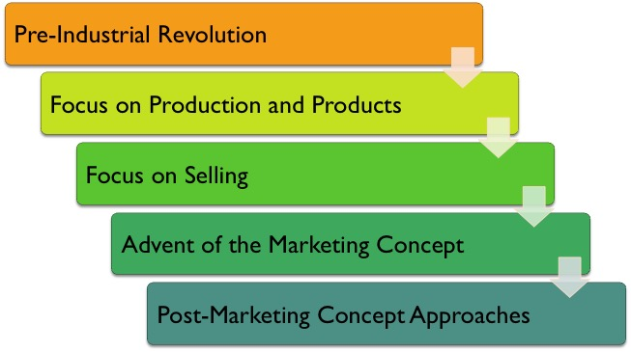
Marketing’s Roots and Evolution
Link to long alt text description
1-13

Slide 14
Pre-Industrial Revolution
Products were customized.
One-to-one marketing.

Slide 15
Production Orientation
Maximizing mass production via assembly line.
Assumes customers will go the producer.
“If you build it, they will come.”
As Henry Ford said, “People can have the Model T in any color—so long that it’s black.”
Notes:
For the early part of the 20th century, the focus was on this production orientation of improving products and production efficiency without much regard for what was going on in the marketplace. In fact, consumers snapped up this new pipeline of reasonably priced goods, even if the products didn’t give much choice in style or function.

Slide 16
Sales Orientation
Salespeople need to push the product.
Production capacity increased post-WW1.
New competitors flooded the market.
More sophisticated financial markets pressured firms to increase sales volume and profitability.
Created the image of the pushy salesperson.
Notes:
For years, the most vivid image of a salesperson in the public eye was that of the peddler, the classic outside salesperson pushing product on customers with a smile, promise, and handshake. Gradually, customers of all kinds grew wary of high-pressure selling, sparking laws at all levels to protect consumers from unscrupulous salespeople. For many customers, the image of marketing became permanently frozen as that of the pushy salesperson. And just as with the production orientation, to this day some firms still practice mainly a sales-oriented approach to their business.

Slide 17
Marketing Concept
After World War II:
Pent-up demand for consumer goods and services.
Euphoric focus on family and getting back to normal.
Increased production for consumer goods.
Sophisticated marketing research enabled by mainframe computers.
Marketing concept spread in the 1960s and 70s:
Led to allowing the market to decide what products it wanted which gave rise to marketing planning.
Notes:
The marketing concept is an organization-wide customer orientation with the objective of achieving long-run profits.
GE wrote the following to stockholders in its 1952 Annual Report (in this historical period, the assumption was that business professionals would be male):
[The marketing concept]. . .introduces the marketing man at the beginning rather than at the end of the production cycle and integrates marketing into each phase of the business. Thus, marketing, through its studies and research, will establish for the engineer, the design and manufacturing man, what the customer wants in a given product, what price he is willing to pay, and where and when it will be wanted. Marketing will have authority in product planning, production scheduling, and inventory control, as well as in sales distribution and servicing of the product.

Slide 18
Marketing Mix
Mid-1960s: The 4 Ps, or marketing mix
Product, price, place, promotion.
Today: More sophisticated view of 4 Ps
Products are offerings; focus is on solutions.
Place is complex supply chains.
Price is viewed as value; benefits/price.
Promotion uses high-tech media.
Notes:
In the mid-1960s, a convenient way of teaching the key components was developed with the advent of the marketing mix, or 4Ps of marketing, originally for product, price, place, and promotion.20 The idea was that these fundamental elements comprise the marketer’s “tool kit” to be applied in carrying out the job. It is referred to as a “mix” because, by developing unique combinations of these elements, marketers set their product or brand apart from the competition. Also, an important rubric in marketing is the following: making a change in any one of the marketing mix elements tends to result in a domino effect on the others.
A favorite marketing professor at the University of South Florida referred to “Place” as Pu-distribution”.
The product is now regarded broadly in the context of an overall offering, which could include a bundle of goods, ser- vices, ideas (for example, intellectual property), and other components, often represented by strong overarching branding. Many marketers today are more focused on solutions than products—the characterization of an offering as a solution is nice because of the implication that a solution has been developed in con- junction with specific, well-understood customer wants and needs.21 Price today is largely regarded in relationship to the concept of value. Place has undergone tremendous change. Rather than just connoting the process of getting goods from Point A to Point B, firms now understand that sophisticated, integrated supply chain approaches are a crucial component of business success. And finally, to grasp the magnitude of changes in promotion since the 1960s one need only consider the proliferation of high-tech media options available to marketers today, from the Internet to cell phones and beyond.

Slide 19
Beyond the Marketing Concept
Differentiation Orientation
Market Orientation
Relationship Orientation
One-to-One Marketing
1-19

Slide 20
Differentiation and Market Orientation
Differentiation Orientation
Clearly communicates how the firms products from competitors.
Market Orientation
Implementation of the marketing concept.
Includes customer orientation: The customer is at the core.
©McGraw-Hill Education. All rights reserved. Authorized only for instructor use in the classroom. No reproduction or further distribution permitted without the prior written consent of McGraw-Hill Education.
Notes:
Differentiation orientation uses different product messages through different media to target very specifically defined customer groups.

Slide 21
Relationship and One-to-One Marketing
Relationship Orientation
Focuses on customer retention.
CRM drives customer satisfaction and loyalty.
One-to-One Marketing
Advocates a learning relationship so that the firm can offer customized products and services.
Mass customization.
Notes:
Differentiation orientation uses different product messages through different media to target very specifically defined customer groups.

Slide 22
Change Drives Impacting the Future of Marketing
Shift to product glut and customer shortage.
Shift in information power from marketer to customer.
Shift in generational values and preferences.
Shift to distinguishing Marketing (“Big M”) from marketing (“little m”).
Shift to demanding return on marketing investment.
1-22

Slide 23
Shift to Product Glut and Customer Shortage
The balance of power is shifting between marketers and their customers, both in B2C and B2B markets.
Not only is a customer orientation desirable, but also in today’s market it is a necessity for survival.
New Market Realities: competitors proliferate, all secrets are open secrets, innovation is universal, information overwhelms and depreciates, easy growth makes hard times, and customers have less time than ever.
1-23
Notes:
Fred Wiersema, in his book The New Market Leaders, builds a powerful case that the balance of power is shifting between marketers and their customers, both in business-to-consumer (B2C/end user) markets and business-to-business (B2B) markets. He identifies “six new market realities” in support of this trend: Competitors proliferate, all secrets are open secrets, innovation is universal, information overwhelms and depreciates, easy growth makes hard times, and customers have less time than ever.

Slide 24
Shift in Information Power from Marketer to Customer
Customers of all kinds have nearly limitless access to information about companies, products, competitors, other customers, and even detailed elements of marketing plans and strategies.
1-24
Notes:
Customers are empowered to access boundless information about all kinds of products and services on the Internet.
For competitive reasons, firms have no choice but to be more open about their businesses and products. Even if they wanted to, firms can’t stop chat rooms, independent Web sites, Web logs or blogs, and other customer-generated modes of communication from filling Web page after Web page with information, disinformation, and opinions about a company’s products, services, and even company dirty laundry.

Slide 25
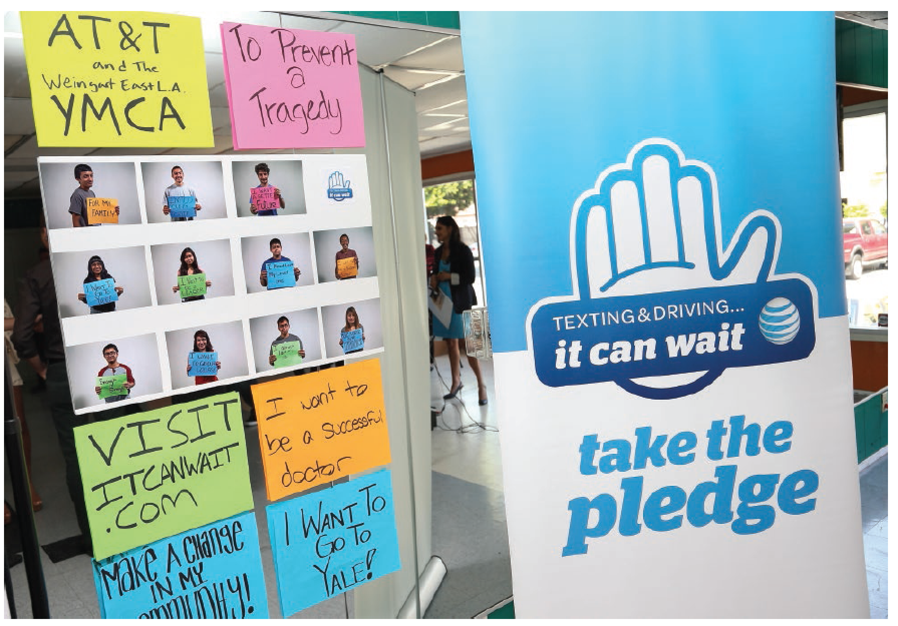
Shift in Generational Values and Preferences
Impacts the firm’s message and the method by which that message is communicated.
Impacts marketing in terms of human resources.
Generational changes are nothing new.
©Imeh Akpanudosen/Getty Images
1-25
Notes:
Gen Y consumers tend to be much more receptive to electronic commerce as a primary mode of receiving marketing communication and ultimately purchasing than are prior generations.
Generational differences in attitudes toward work life versus family life, expectations about job satisfaction and rewards, and preferred modes of learning and working (e.g., electronic versus face-to-face) affect the ability of firms to hire people into various marketing-related positions.

Slide 26
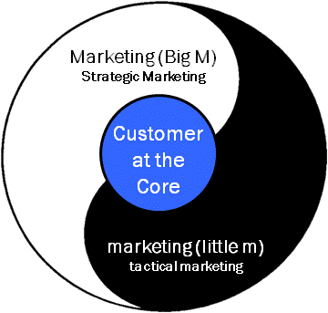
Distinguishing Between Marketing (“Big M”) and marketing (“little m”)
Marketing (Big M)
Strategic marketing, means a long-term, firm-level commitment to investing in marketing – supported at the highest organization level – for the purpose of enhancing organizational performance.
marketing (little m)
Tactical marketing, which serves the firm and its stakeholders at a functional or operational level.
Link to long alt text description
1-26
Notes:
Marketing (Big M) serves as a core driver of business strategy. That is, an understanding of markets, competitors, and other external forces, coupled with attention to internal capabilities, allows a firm to successfully.
• Make sure everyone in an organization, regardless of their position or title, understands the concept of customer orientation.
• Align all internal organizational processes and systems around the customer.
• Find somebody at the top of the firm to consistently champion this Marketing (Big M) business philosophy.
• Forget the concept that the marketing department is where Marketing (Big M) takes place.
• Create market-driving, not just market-driven, strategies.
marketing (little m) almost always takes place at the functional or operational level of a firm. Specific programs and tactics aimed at customers and other stakeholder groups tend to emanate from marketing (little m). But marketing (little m) always needs to be couched within the philosophy, culture, and strategies of the firm’s Marketing (Big M). In this way, Marketing (Big M) and marketing (little m) should be quite naturally connected within a firm, as the latter tends to represent the day-to-day operationalization and implementation of the former. Everything from brand image, to the message salespeople and advertisements deliver, to customer service, to packaging and product features, to the chosen distribution channel—in fact, all elements of the marketing mix and beyond—exemplify marketing (little m).

Slide 27
Shift to Justifying the Relevance and Payback of the Marketing Investment
How can management effectively measure and assess the level of success a firm’s investment in various aspects of marketing?
Metrics must be designed for key benchmarks for improvement.
1-27

Slide 28
Marketing Metrics
Marketing is a fuzzy field.
If it can’t be measured, it can’t be managed.
Is marketing an expense or an investment?
CEOs and stockholders expect marketing accountability.
Link to long alt text description
1-28
Notes:
Marketing is a fuzzy field. Marketing has often historically viewed itself as working within gray area comfort zones of a business. That is, if what marketing contributed was mostly creative in nature, how can the impact of such activities effectively be measured? For the marketer, this can be a somewhat attractive position to be in, and historically many marketers probably took advantage of the idea that their activities were above measurement. Those days are over.
If it can’t be measured, it can’t be managed. As with all aspects of business, effective management of the various aspects of marketing requires quantification of objectives and results. The marketing plan is one of the most important elements of a business plan. Effective planning requires metrics.
Is marketing an expense or an investment? Practicing marketers tend to pitch marketing internally as an investment in the future success of the organization. As an investment, it is not unreasonable that expected returns be identified and measured.
CEOs and stockholders expect marketing accountability. Leading consulting firm McKinsey & Company uses its Marketing Navigator to translate complex Marketing Return on Investment (MROI) data into simplified visualizations to help its clients make better marketing investment decisions. McKinsey believes that better MROI begins with better objectives, and communicating marketing as an investment, not a cost

Slide 29
Alt Text Appendix
All long alt text descriptions are included in this appendix.

Slide 30
Marketing’s Roots and Evolution
The pre-Industrial Revolution led to a focus on production and products. The focus then shifted to selling, which marked the advent of the marketing concept. This led to post-marketing concept approaches.
1-30

Slide 31
Distinguishing Between Marketing (“Big M”) and marketing (“little m”)
Marketing (Big M), which is strategic marketing, and marketing (little m), which is tactical marketing, work together. The customer remains at the core.
1-31

Slide 32
Marketing Metrics
1. Marketing is a fuzzy field. 2. If it can’t be measured, it can’t be managed. 3. Is marketing an expense or an investment? 4. CEOs and stockholders expect marketing accountability.
1-32

